Slide 1
Ensemble Classifier for Protein Fold Pattern Recognition
Bioinformatics, Vol.22, no.14, 2006, pages 1717–1722
Hong-Bin Shen, Kuo-Chen Chou
Presenter: Jun-Shong Lin
Date: Mar. 7, 2007

Slide 2
Abstract
Motivation: Prediction of protein folding patterns is one level deeper
than that of protein structural classes, and hence is much more
complicated and difficult. To deal with such a challenging problem,
the ensemble classifier was introduced. It was formed by a set of
basic classifiers, with each trained in different parameter systems,
such as predicted secondary structure, hydrophobicity, van der
Waals volume, polarity, polarizability, as well as different dimensions
of pseudo-amino acid composition, which were extracted from a training
dataset. The operation engine for the constituent individual classifiers
was OET-KNN (optimized evidence-theoretic k-nearest neighbors)
rule. Their outcomes were combined through a weighted voting to
give a final determination for classifying a query protein. The recognition
was to find the true fold among the 27 possible patterns.

Slide 3
Abstract (Cont.)
Results: The overall success rate thus obtained was 62% for a
testing dataset where most of the proteins have <25% sequence
identity with the proteins used in training the classifier. Such a rate
is 6–21% higher than the corresponding rates obtained by various
existing NN (neural networks) and SVM (support vector machines)
approaches, implying that the ensemble classifier is very Promising
and might become a useful vehicle in protein science, as well as
proteomics and bioinformatics.

Slide 4
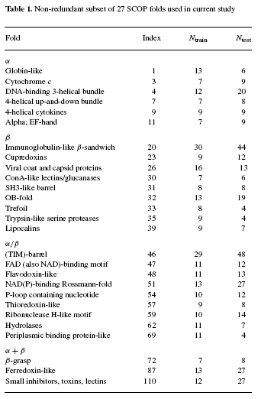
27 Most Populated Folds
Training Data: 311 proteins.
Testing Data: 383 proteins.
SCOP:
Class
Common Fold
Superfamily
Family
Domain

Slide 5
Materials and Methods
Amino acid composition.(20D)
Predicted secondary structure.(21D)
Hydrophobicity.(21D)
Normalized van der Waals volume.(21D)
Polarity.(21D)
Polarizability.(21D)
Helix (H) ,Strand (E) and Coil (C).
Three Descriptors:
Composition(3), Transition(3), Distribution(15)

Slide 6
Materials and Methods
In the present study, in order to avoid completely ignoring the sequence-order effects, the pseudo-amino acid composition was used to replace the conventional amino acid composition.
The hydrophobicity and hydrophilicity of the constituent amino acids in a protein play a very important role to its folding.

Slide 7

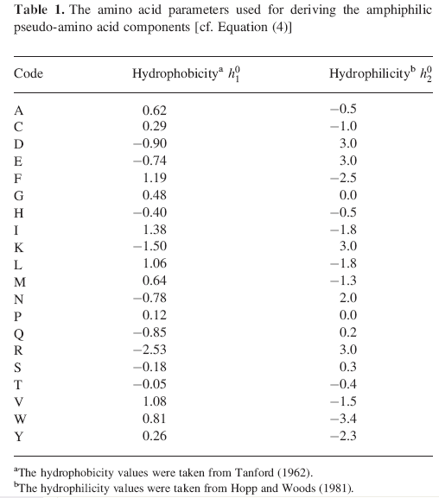

Materials and Methods

Slide 8
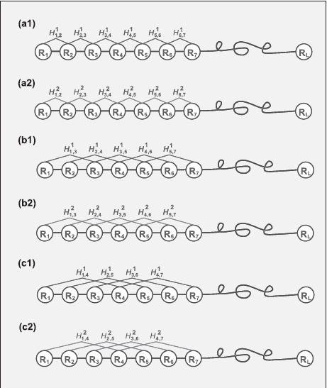
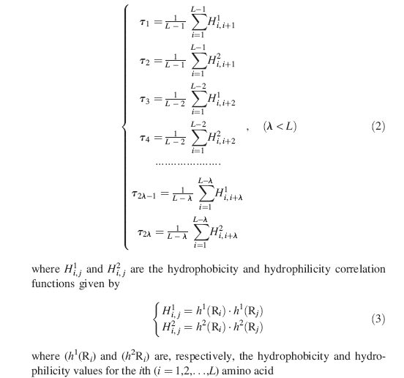
Materials and Methods

Slide 9
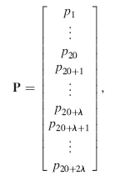
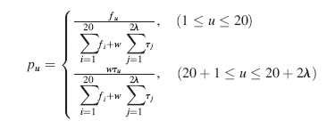
Materials and Methods
By fusing the 2λ amphiphilic correlation factors into the classical amino acid composition, we have the following augmented discrete form to represent a protein sample P:
w = 0.5

Slide 10
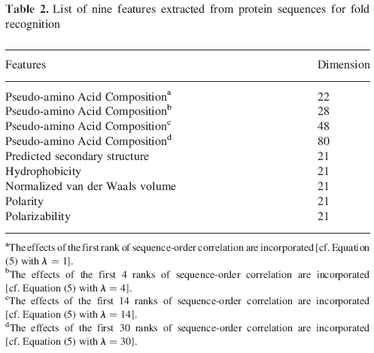
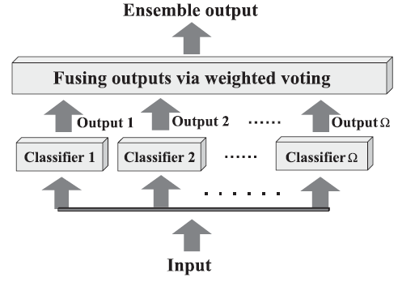
Materials and Methods
OET-KNN Classifier

Slide 11
The Optimized Evidence-Theoretic K-Nearest Neighbors (OET-KNN) Classifier
KNN( k-nearest neighbors ):

Slide 12
The Optimized Evidence-Theoretic K-Nearest Neighbors (OET-KNN) Classifier
ET-KNN (evidence theoretic k-nearest neighbors) rule:
where α₀ is a fixed parameter, γ_{µ} is a parameter associated with
class φ_{µ} and D²(P_{i}, P) is the square Euclidean distance between
P and P_{i}.
In the ET-KNN rule, it was not addressed how to optimally
select the parameters.

Slide 13
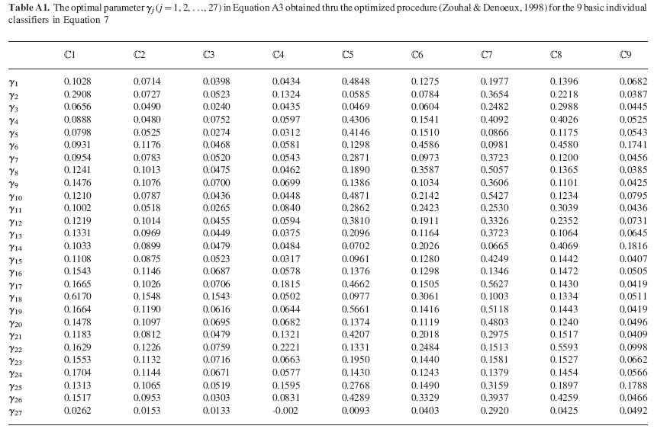
The Optimized Evidence-Theoretic K-Nearest Neighbors (OET-KNN) Classifier
In 1998, an optimization procedure to determine the optimal or near-optimal parameter values was proposed from the data by minimizing an error function.
The optimal parameter:
α₀ = 0.95.
γ_{µ}

Slide 14
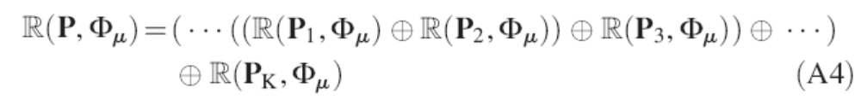
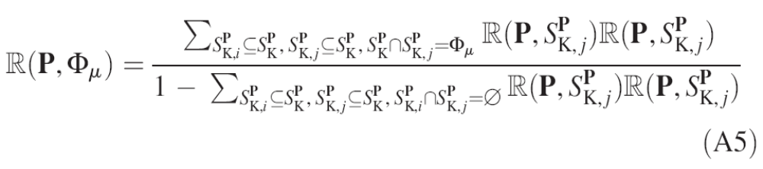
The Optimized Evidence-Theoretic K-Nearest Neighbors (OET-KNN) Classifier
The belief function of P belonging to class φ_{µ} is a combination of its k-nearest neighbors, and can be formulated as
orthogonal sum

Slide 15
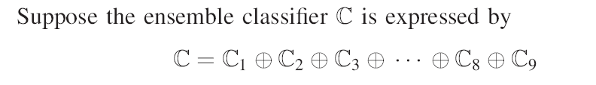

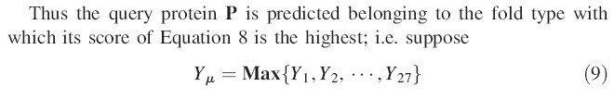
Materials and Methods
Fusing operator

Slide 16
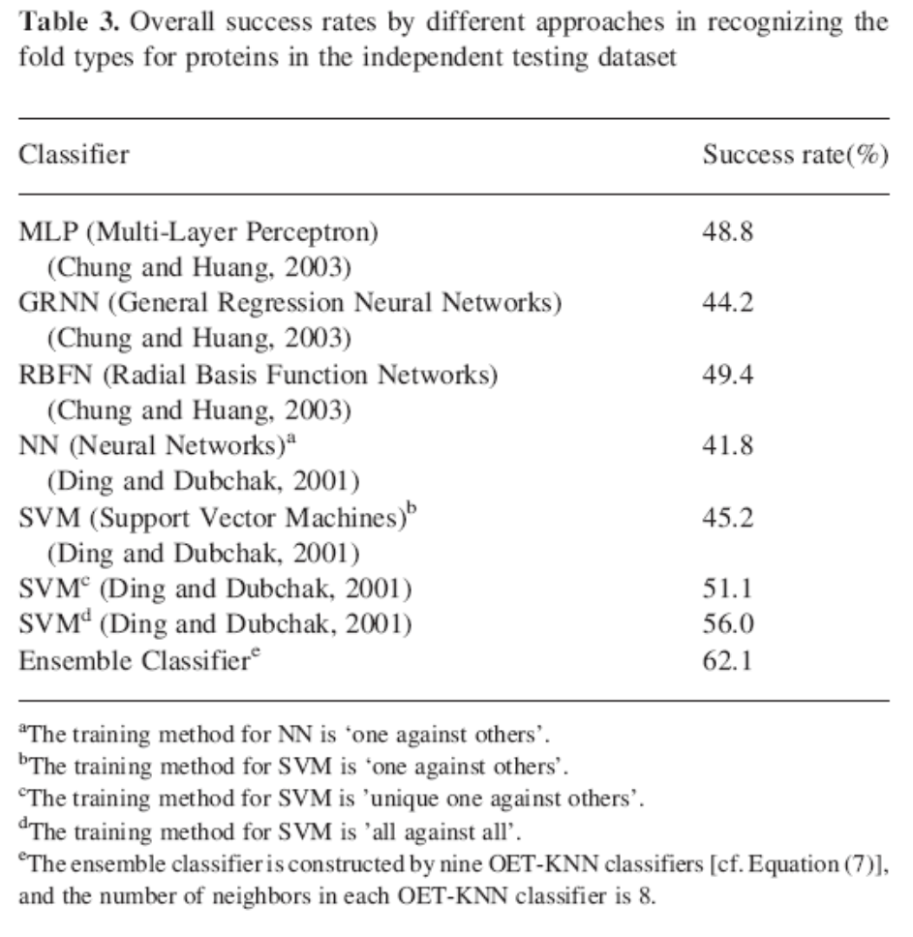
Materials and Methods
It is instructive to note that if using each of the nine basic classifiers C1, C2, C3, C4, C5, C6, C7, C8, C9 to do the same prediction, the success rates would be 0.40, 0.44, 0.40, 0.29, 0.42, 0.37, 0.32,0.29, 0.24, respectively.
These single classifier rates were assigned for the weights w_{i} (i=1,2, . . . , 9) in Equation (9) to form the ensemble classifier.

